Slide 1

Introduction to Machine Learning
By
Dr. Prashant Singh Rana
Computer Science & Engineering Department, Thapar Institute of Engineering and Technology, Patiala, Punjab.
www.psrana.com | psrana@gmail.com

Slide 2
Lets Start

Slide 3
What is Machine Learning ?

Slide 4
Explore
Go to google and search for “Teachable Machine” or
Click on “https://teachablemachine.withgoogle.com”

Slide 5
Basics Idea
Basic Idea for ML
Experimental Dataset
Build ML Model
Make Prediction on new Input/Dataset

Slide 6

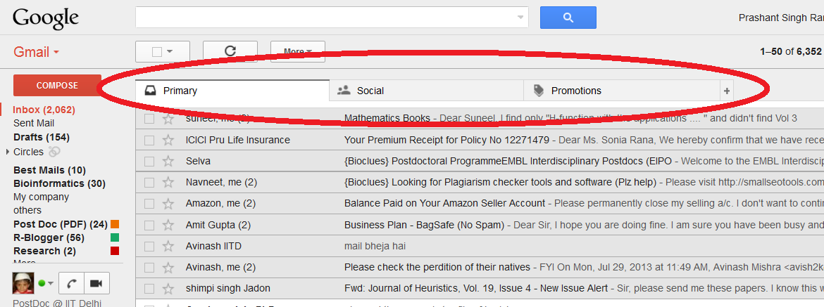
What is Machine Learning ?
Example1: email classification in Gmail

Slide 7
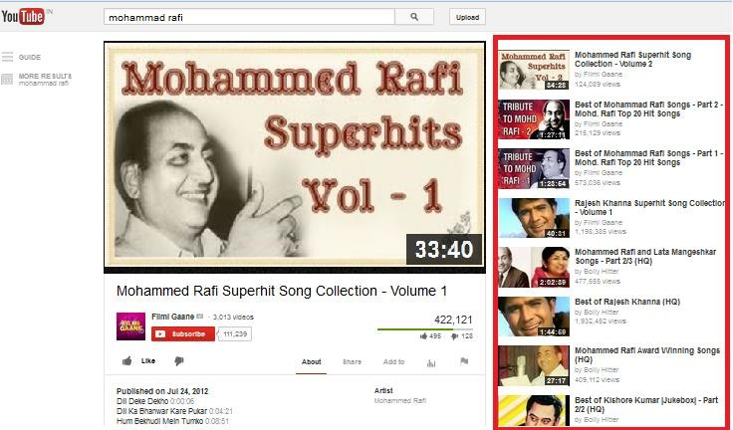
What is Machine Learning ?
Example2: suggestion in youtube

Slide 8
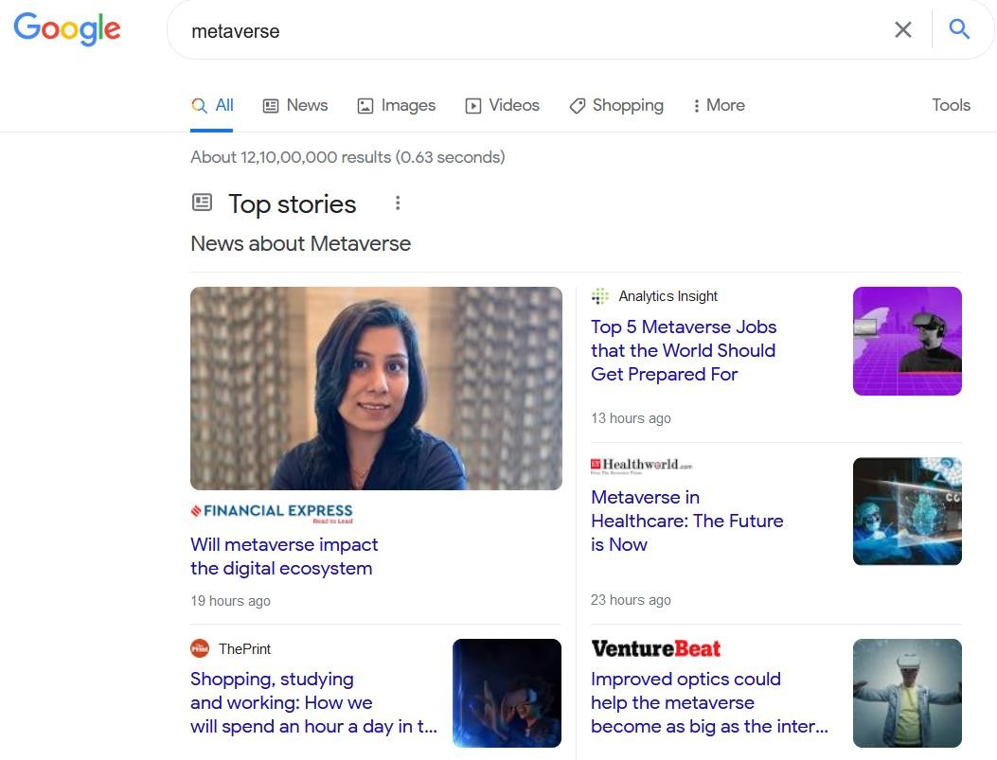
What is Machine Learning ?
Example3: Google News → Search for “Metaverse”

Slide 9
What is Machine Learning ?
Some more examples
Classification of e-mail into SPAM or NON-SPAM
Classification of transaction as FRAUD or GENUINE
Patients diagnosed as DIABETIC or NON-DIABETIC
Gene Classification into CODING or NON-CODING.
…… Many more.

Slide 10
What is Machine Learning ?

Slide 11
What is Machine Learning ?
Simple Definition I - Branch of Artificial Intelligence that gives computers to learn without being explicitly programmed.
Simple Definition II - Branch of Artificial Intelligence, about to construct a system that learn from data.
Actual Definition - A computer program is said to learn from experience E with respect to some task T and some performance measure P, if its performance on T, as measured by P, improves with experience E.

Slide 12
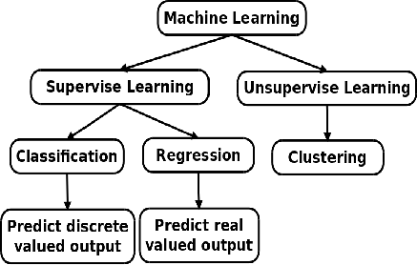




Categories of Machine Learning

Slide 13
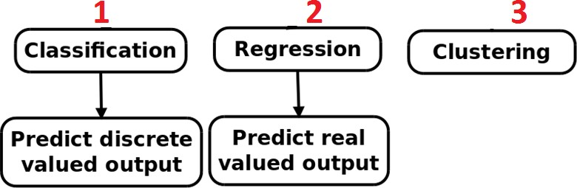


You have to only deals with ……..

Slide 14
Examples
Regression Problem
Prediction of wheat production.
Prediction of rainfall.
Point prediction of Stock Exchange.
Classification Problems
Prediction of cancer.
Win prediction of Sheila Dixit.
Diabetic Prediction.
Classification of e-mail.

Slide 15
Examples
Clustering
Grouping of NEWS.
Grouping the people on their similar hobbies/interests.
Grouping of animals.
Grouping of customers based on their performance.
E.g. bank customers.
………….. Many more.

Slide 16
Data Set format for Machine Learning
Explore
Sample Dataset

Slide 17
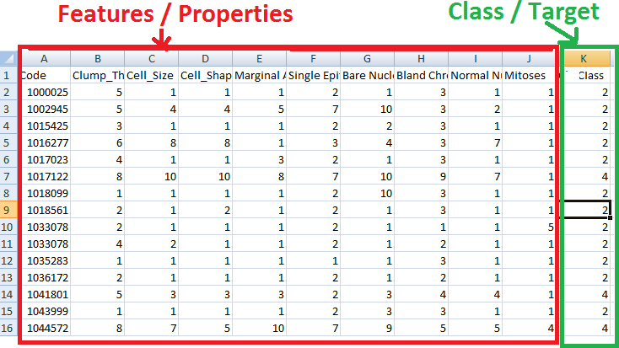





Understand the Data……..

Slide 18
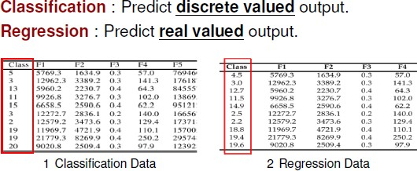
Classification & Regression

Slide 19
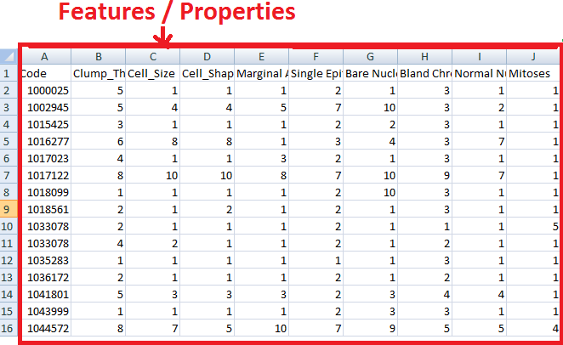
Clustering Data
Only Features; No class/target/label

Slide 20
Basics Idea
Basic Idea for ML
Experimental Dataset
Build ML Model
Make Prediction on new Input/Dataset

Slide 21
Example1: Applying Liner Model
1. Experimental Dataset
X1 | X2 | X3 | X4 | Output
5 | 1 | 1 | 3 | 25
1 | 5 | 5 | 1 | 20
2 | 3 | 1 | 3 | 27
4 | 2 | 5 | 4 | 29
1 | 4 | 5 | 5 | 30
4 | 5 | 3 | 2 | 21
5 | 5 | 1 | 1 | 30
3 | 2 | 1 | 4 | 29

Slide 22
Example1: Applying Liner Model
Data se equation banana
2. Build
ML Model
Linear Model
Y= w1 x1 + w2x2 + w3x3 + w4x4
Output = 9x1 + 6x2 - 10x3 + 5x4

Slide 23
Example1: Applying Liner Model
3. Make Prediction on
new Input/Dataset
new Input →
X1 | X2 | X3 | X4 | Output
3 | 4 | 2 | 2 | ?
Apply Linear Model
Output = 9x1 + 6x2 - 10x3 + 5x4
= 9*3 + 6*4 – 10*2 + 5*2
= 41

Slide 24
Example2: Applying Decision Tree
1. Experimental Dataset
X1 | X2 | X3 | Output
5 | 1 | 1 | 0
1 | 5 | 5 | 0
2 | 3 | 1 | 1
4 | 2 | 5 | 0
1 | 4 | 5 | 1
4 | 5 | 3 | 1
5 | 5 | 1 | 0
3 | 2 | 1 | 1

Slide 25
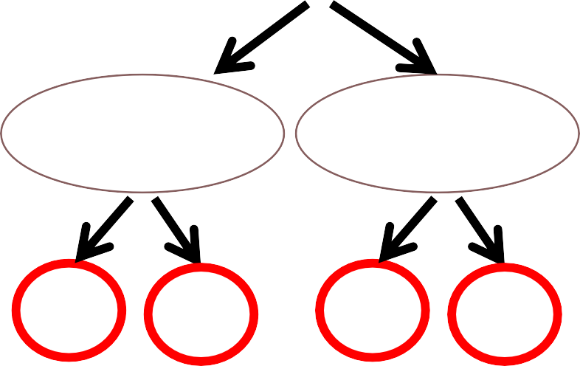
Example2: Applying Decision Tree
2. Build
ML Model
X1<= 3
X2<=2
X2 > 3
X3<=2
X3>2
X3 <=1
X3 > 1
0
1
0
1
0
1
0
1

Slide 26
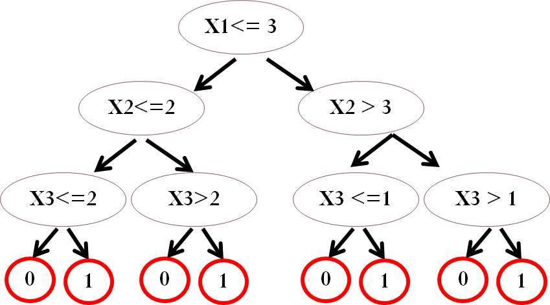
Example2: Applying Decision Tree
3. Make Prediction on
new Input/Dataset
new Input →
X1 | X2 | X3 | Output
3 | 4 | 2 | ?
Apply Decision Tree
Output = 0

Slide 27
Machine Learning models
Most Common models
Decision tree model
Random forest
SVM (Support Vector Machine)
Linear Model
Neural Network

Slide 28
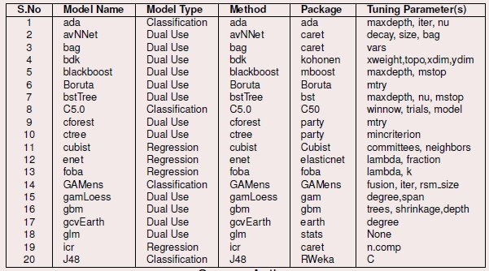
Machine Learning models

Slide 29
Machine Learning models
Already 500+ ML models are available for prediction
Go for New Model Building
Applied Modelling (Use existing models and solve real-world problem)

Slide 30
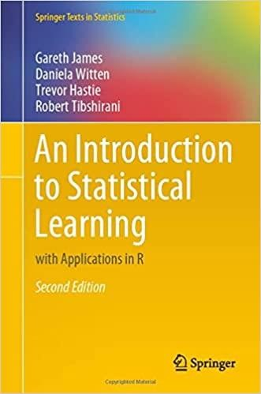
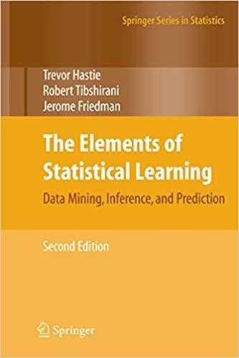
Books
Best Book for ML

Slide 31
Types of Models
Linear Model
Y= w1 x1 + w2x2 + w3x3 + w4x4 + w5x5
Tree Based model
X1 < 40
X2 < 10
X2 < 90
X3 < 5
X3 < 9
X3 < 10
X3 < 90

Slide 32
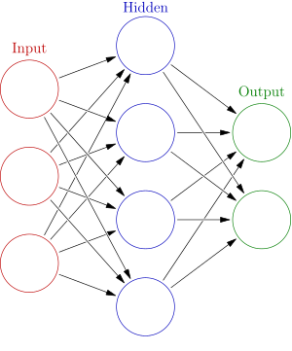
Types of Models……..
Neural Network

Slide 33
Resources?
www.psrana.com
leadingindia.ai
→ Resource
→ Resources

Slide 34
Image Colorization

Slide 35
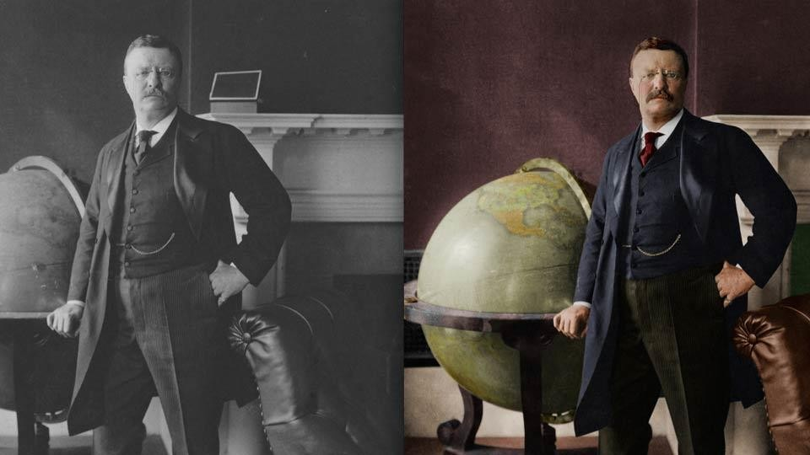
More Examples…..

Slide 36
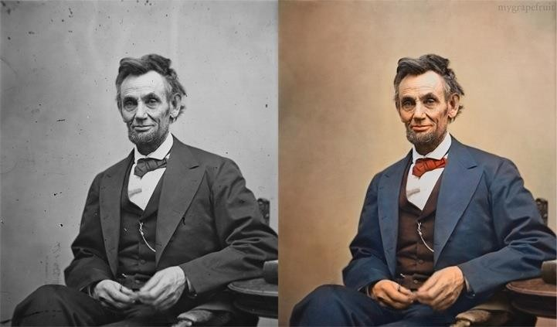
More Examples…..

Slide 37
Can you think any APPLICATION that can be developed using
Image Colorization??

Slide 38
Convert Black & White movies
to Colored.

Slide 39
Methodology/Approach ??

Slide 40




Approach
GAN → Generative Adversarial Networks (invented by Ian Goodfellow in 2014 in Beer Bar)

Slide 41




Approach…….

Slide 42
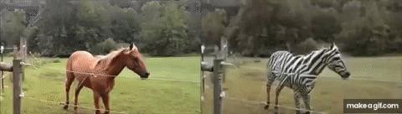
Outcome

Slide 43
Product (Web Service)
Example: Online Doc to PDF Converter
Web Interface
File Name
Email Id
Browse File....
psrana@gmail.com
Submit

Slide 44
Product (Web Service)
B&W to Colour
Web Interface
File Name
Email Id
Browse B&W movie file....
psrana@gmail.com
Submit

Slide 45
How to create Web Applications??
Django
Flask

Slide 46
Hottest Topics ???

Slide 47
Hottest Topics Research / Projects
Deep Learning
Machine Learning
Transfer Learning
Reinforcement Learning
IoT
Big Data Analytics
Virtual Reality
Block Chain
NLP (Natural Language Processing)
Image Processing or Computer Vision
……….many many more

Slide 48
How to get the ideas
for Project/Research
(A Million Dollar Question)

Slide 49
For Project Idea: Explore
It is not a job of single day.

Slide 50
For Project Idea: Explore
It is not a job of single day.
Explore
Hackathons, Funding agency site, Project calls, etc
Study
Case study, Funding stories (YourStory.com)
Discuss
With Friend, Faculty,Teacher, Mentor, Students
Build Team and Implement
Present

Slide 51
For Project Idea: Note it down
For any new idea just prepare 1-2 page writeup
Title
Methodology
Expected Outcome
Requirement (equipment)

Slide 52
1. Leading India AI
www.LeadingIndia.ai
For Project Idea

Slide 53

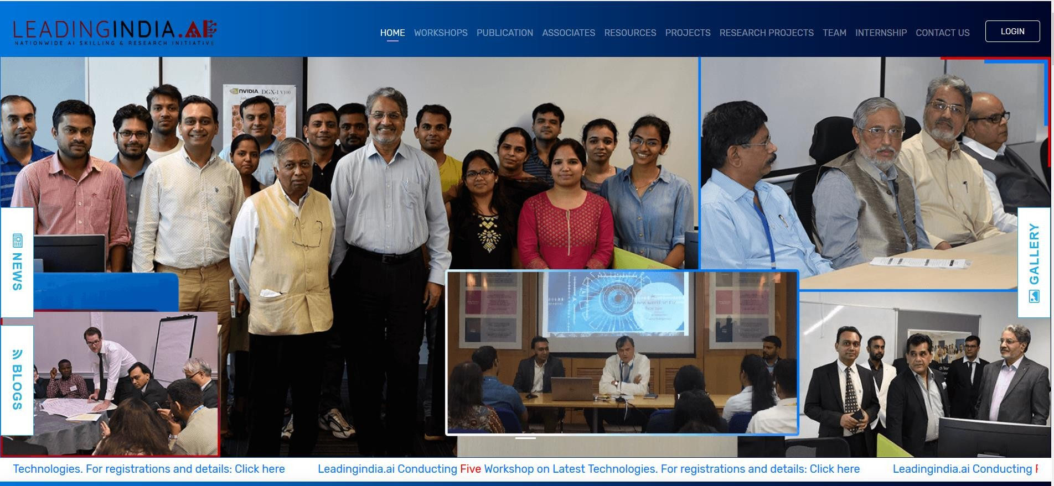
For Project Idea
Leading India AI
www.LeadingIndia.ai (AI/ML based problems)
Lead by Prof. Deepak Garg
Ready made AI/ML based problem statement. Explore: Projects, Resources, Research Projects

Slide 54
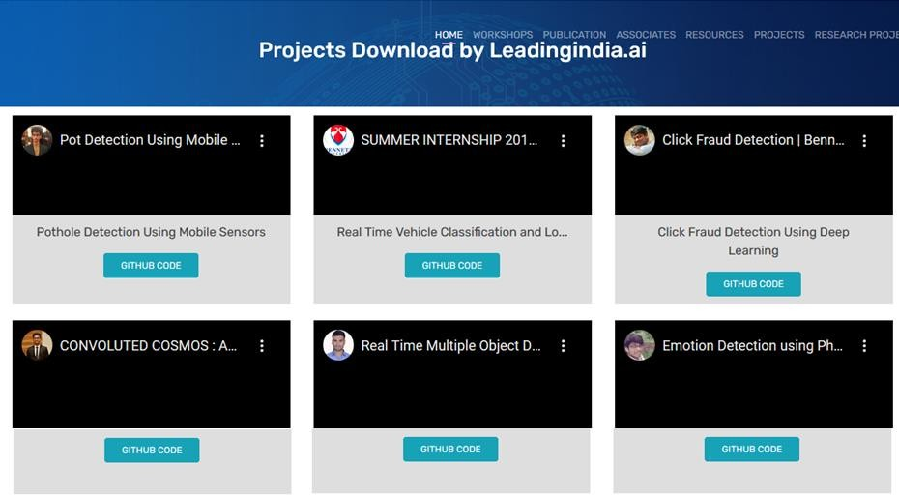
Project Idea: LeadingIndia.ai
Go to → leadingindia.ai → Projects

Slide 55
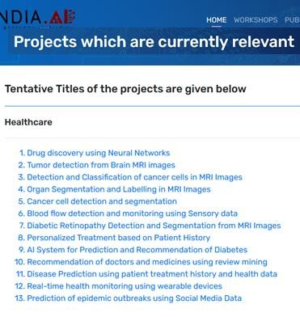
Project Idea: LeadingIndia.ai
Go to → leadingindia.ai → Research Projects

Slide 56
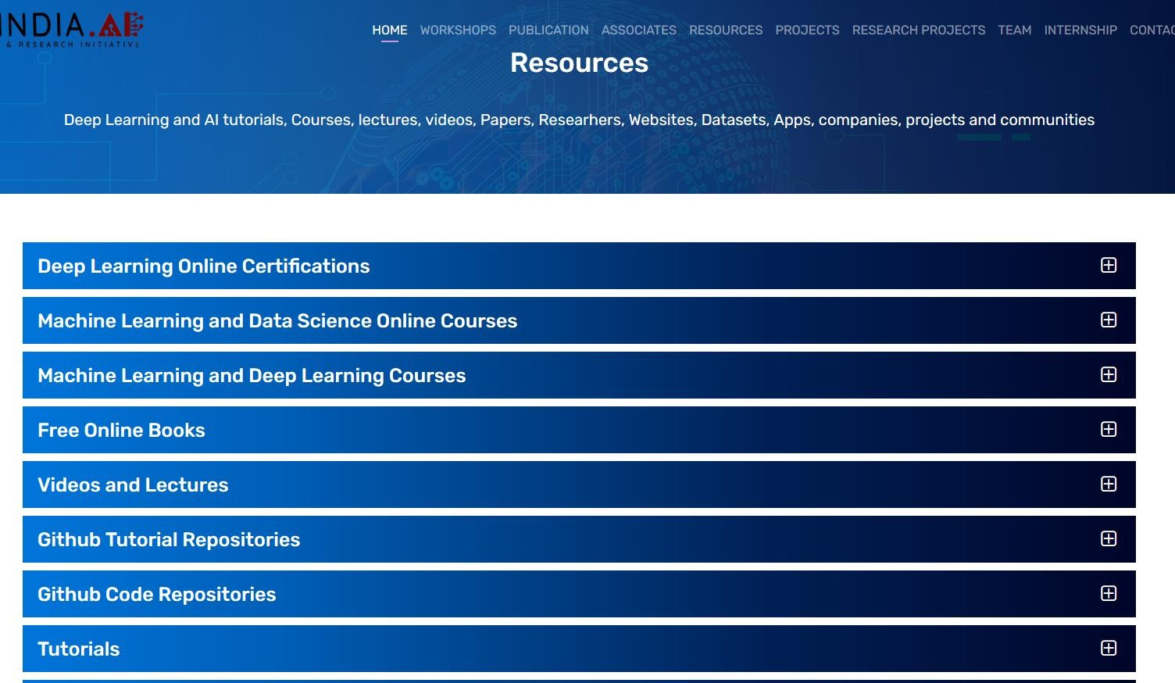
Project Idea: LeadingIndia.ai
Go to → leadingindia.ai → Resources

Slide 57
For Project Idea: SIH
2. Smart India Hackathon (SIH)
www.sih.gov.in

Slide 58
For Project Idea: SIH
Winner in Smart India Hackathon (SIH) from Thapar
2017 → 01 Team (3rd position)
2018 → 01 Team (2nd position)
2019 → 05 Teams (1st Position (04)
and 2nd (01))
2020 → 02 Teams (1st Position (02))

Slide 59
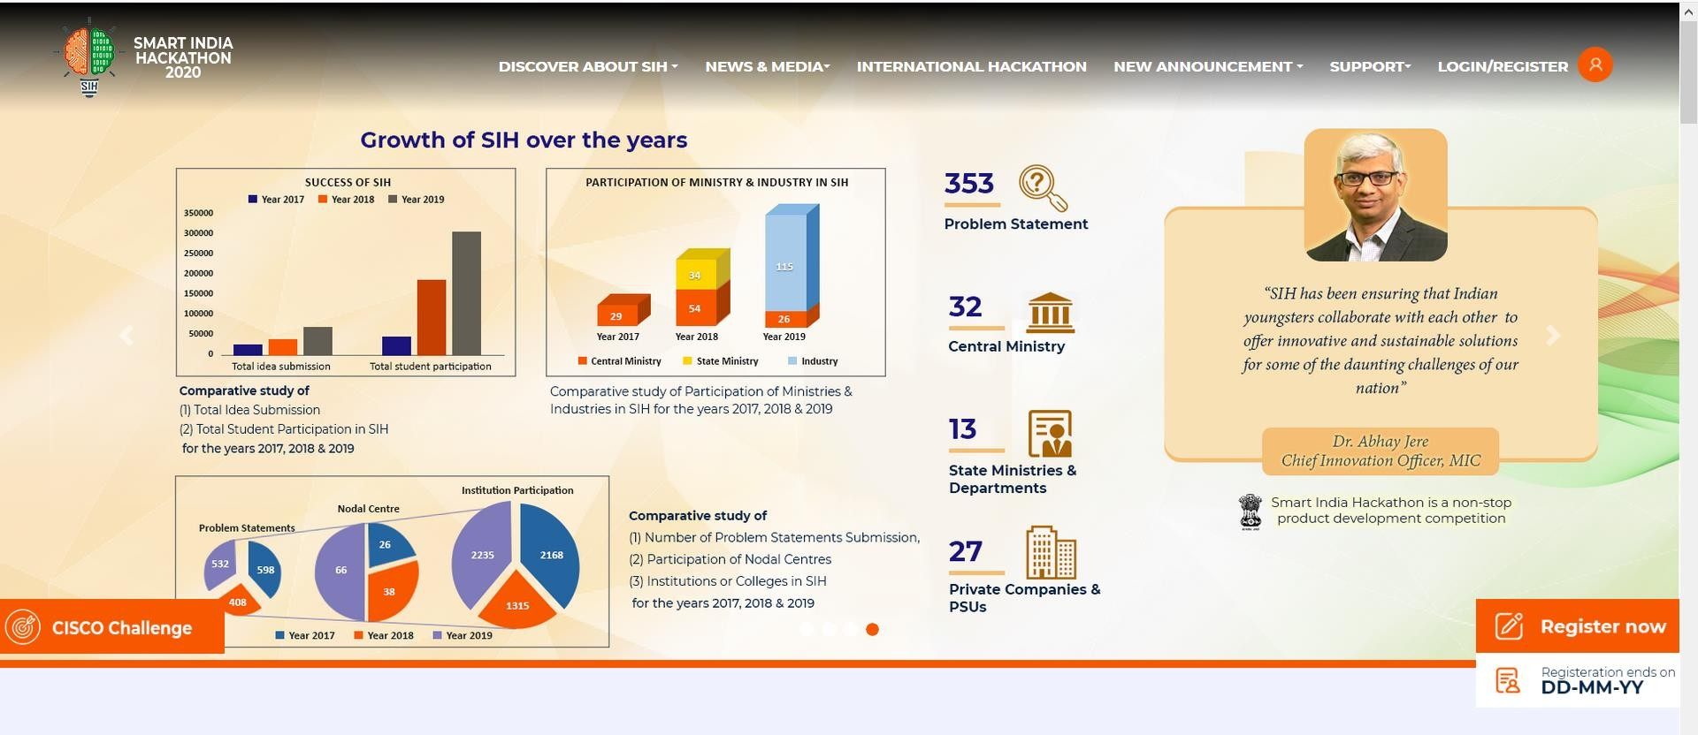
For Project Idea: SIH
Smart India Hackathon (SIH)
www.sih.gov.in (Best resource for project idea)
Explore problem statements of current and previous years. 353 problems in 2020 from different agencies and ministries.

Slide 60
3. Innocentive
www.innocentive.com
For Project Idea

Slide 61
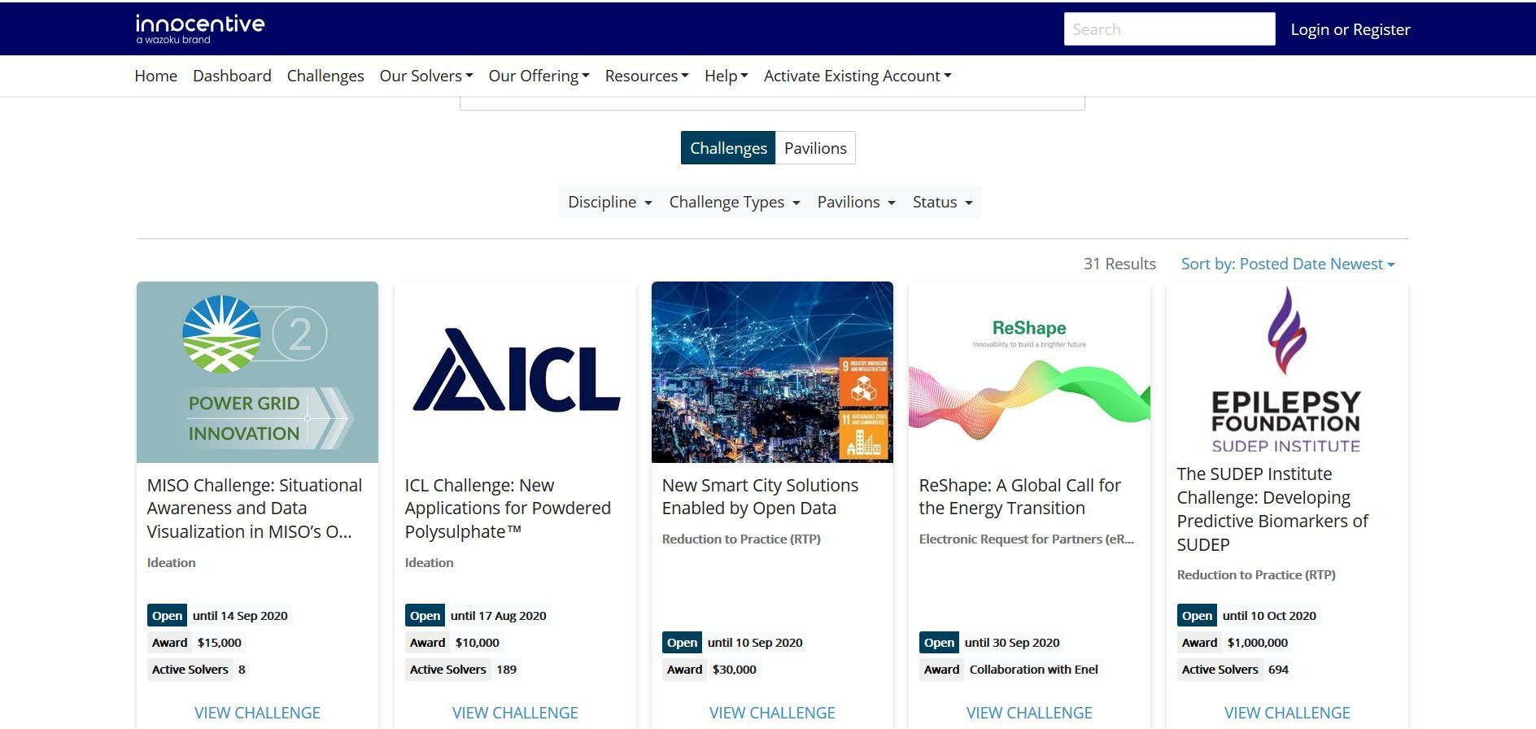
For Project Idea
Innocentive
www.innocentive.com (Real life problems)
Go to Challenge Center → Challenges
Ready made Problem statement, Literature, outcome and price money.
Expected

Slide 62
4. Kaggle
www.kaggle.com
For Project Idea

Slide 63
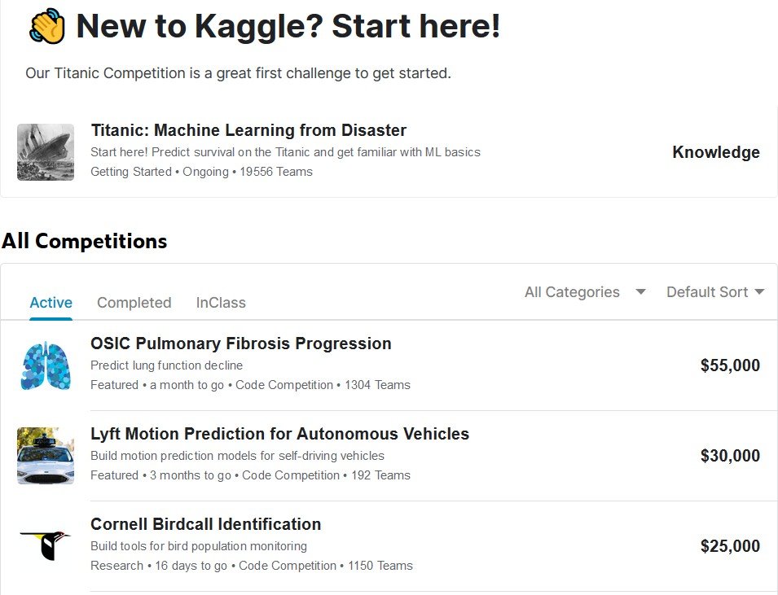
For Project Idea
Kaggle
www.kaggle.com (Data Science problems) → Compete
Ready made Problem statement, Literature, Expected outcome and price money.

Slide 64
What is Structured, Semi- Structured and Unstructured Data??

Slide 65
Unstructured Data
No format is defined
Example:
1000 movies in a folder
10k docs in a folder
500 images in a folder
……………….. many more

Slide 66
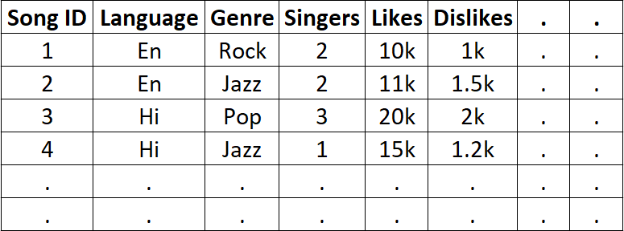
Structured Data
Stored in well defined format
Example: Song

Slide 67
Semi-structured Data
Little format is defined
Example:
1000 movies in three folder (12+, 16+,
18+)
10k docs in 4 folder (A, B, C, D)
500 photos in two folder (Male, Female)
10k tweets in two files (-ve, +ve)
……………….. many more

Slide 68
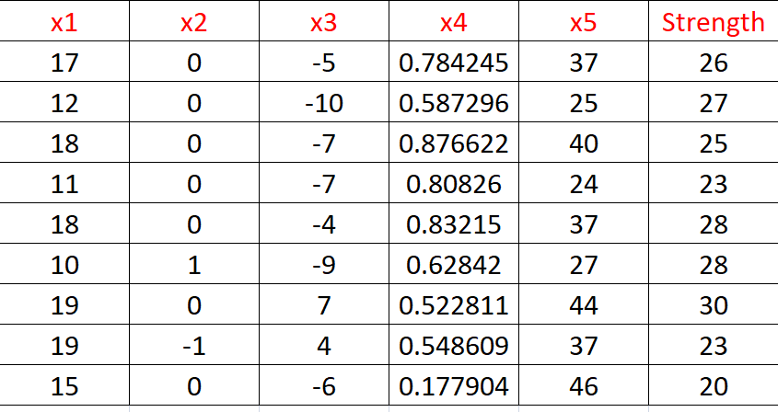
Data Set format for Machine Learning
Multiple columns and one column is labelled (Strength)

Slide 69
Difference between Machine Learning & Deep Learning ??

Slide 70
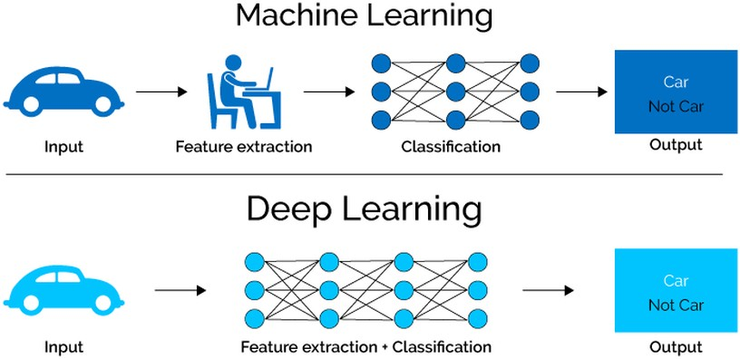

Slide 71
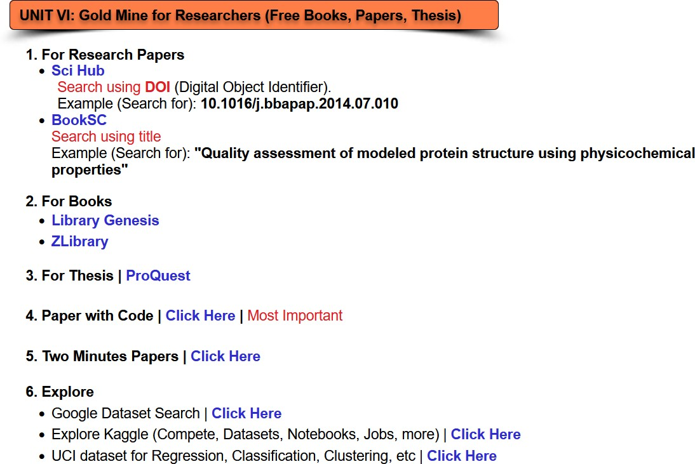
Additional Resources
Explore → psrana.com → Resources

Slide 72
Where to get papers?

Slide 73
Where to get papers?
Sci Hub
www.sci-hub.tw
* Domain name changes time to time.

Slide 74
Where to get Books?

Slide 75
Where to get Books?
Library Genesis
http://gen.lib.rus.ec
* Domain name changes time to time.

Slide 76
Best Resource
Papers with Code
www.paperswithcode.com
Find recent paper in Machine Learning / Deep learning / Computer Vision / Natural Language Processing / etc
Github code is available with every paper.

Slide 77
Explore Hackathons

Slide 78
Explore Hackathons
Helps in selecting research topics.
www.kaggle.com www.chalearn.org www.mlwave.com www.tunedit.org www.codalab.org www.gesture.chalearn.org www.innocentive.com www.dreamchallenges.org www.crowdanalytix.com
www.datahack.analyticsvidhya.com www.numer.ai www.genomeinterpretation.org http://grandchallenges.org/

Slide 79
Join Mailing Groups?

Slide 80
Join Mailing Groups?
Helps in selecting research topics, recent news and updates
http://bit.ly/MachineLearningBlogAndResource http://feedburner.google.com/fb/a/mailverify?uri=analyticsvidhya http://www.innocentive.com/blog https://www.crowdanalytix.com/blog http://www.kdnuggets.com/news/subscribe.html
http://www.r-bloggers.com/blogs-list/

Slide 81
Learn Fast

Slide 82
Learn Fast
To learn FAST Learn from slides.
Learn from Youtube / Videos.

Slide 83
Code Sharing

Slide 84
Code Sharing
1. Share your code on GitHub
https://github.com

Slide 85
Present your work

Slide 86
Present your work
Given Weekly / Monthly Presentation to you friends, boss, students, kids or to your wife.
Record it and improve it.

Slide 87
Tools and Techniques
Python libraries
Numpy & Scipy
Pandas
Matplotlib
Scikit-learn
StatsModels
Seaborn
Plotly
Pydot
Fundamental Scientific Computing
Data Manipulation and Analysis
Plotting and Visualization
Machine Learning and Data Mining
Statistical Modelling,Testing, and Analysis
For Statistical Data Visualization
For sophisticated graphics
For complex oriented and non-oriented graphs
* Install and explore the above libraries.

Slide 88
Tools and Techniques
Tool: Anaconda
IDLE for Python
Google Colab
Online Jupyter notebook for Python
Widely used platform for ML & DL

Slide 89
Data Set
Google Dataset Search
datasetsearch.research.google.com
Kaggle
www.kaggle.com
Explore (Compete, Datasets, Notebooks, Jobs, more)
UCI dataset
Google it “UCI Dataset”
Dataset available for Regression, Classification, Clustering

Slide 90

Finally
Learning by Doing
90

Slide 91
Thanks Q & A
Learning by Doing
Contact www.psrana.com | psrana@gmail.com

